Slide 1
Sit with someone you don’t know!
Day 9
5 August 2017

Slide 2
JavaScript Juggernauts
Day 9
5 August 2017

Slide 3

This will soon be you…
JavaScript Juggernauts.

Slide 4

But right now…
Maybe feeling like
JavaScript Jellybeans.

Slide 5
Transformation to Come
HANG IN THERE!

Slide 6
Today’s Class

Slide 7
Objectives
In today’s class we’ll be covering:
JavaScript Functions
JavaScript Objects
Building Simple JavaScript Applications

Slide 8
7 Universal Programming Tools
Variables (Containers for Data)
Functions (Do work on Data)
Objects (Don’t worry about it right now)
Arrays (What we all want at work, or working with lists of things)
Loops (Doing things over and over)
Conditionals / Flow Control (Making Decisions)
Basic Math ( + - * / )

Slide 9
Functions

Slide 10
> YOUR TURN!!
Activity: 25-LoopTV | Suggested Time: 10 min
Code Dissection: Array Building
Run the program sent to you via slack. 25-LoopTV/loop-tv-unsolved.html and readme.md
Then, with a partner, fill in the missing comments for each line of code.
Make sure both of you can fully explain what each line means.
Be prepared to share with the class.

Slide 11
Demo Time
Instructor: Demo
(SuperHeroLogging_NoFunctions.html | 2-SuperHeroLogging)
26-SuperHeroLogging

Slide 12
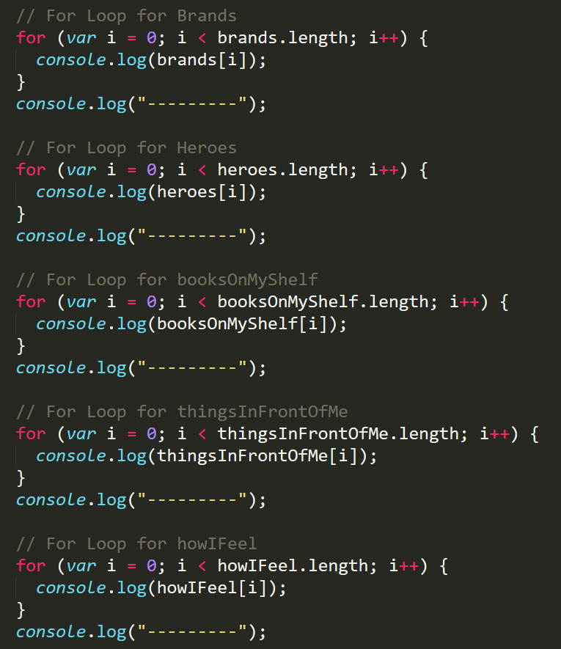
Mondo Repetitive…
Who wants to maintain this??
Hint: No one.

Slide 13
Demo Time
Instructor: Demo
(SuperHeroLogging_WithFunctions.html | 2-SuperHeroLogging)

Slide 14
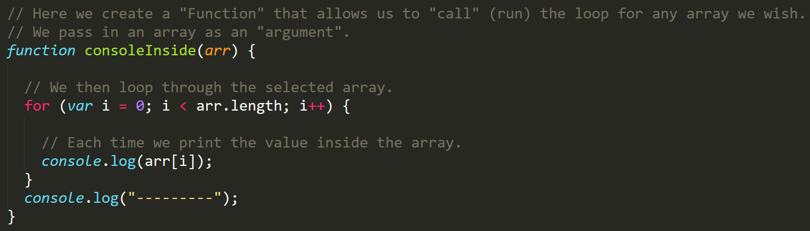
Much Better with Functions!
Squeaky Clean Code.
Minimal repetition
What do we call it when we make our code better / shorter / easier to read or maintain without adding new features?

Slide 15
Pr0grammer W0rds
Refactoring: Changing code in a way that makes it “cleaner”, easier to read, easier to maintain, easier to debug, or more concise (but never at the expense of the other objectives).
Obfuscation: Purposefully making code harder to understand or maintain.

Slide 16
Pr0grammer W0rds
Pseudocode: using short-hand “fake code” to express how real code might be written. Popularly found on whiteboards, post-it notes, cocktail napkins, and sometimes the lead developers arm.
This isn’t working javascript, but there’s enough there to give you an idea of what I want you do to.
X = 2
For i = 1 to 10
if i is odd then
write to log (i * x)

Slide 17
> YOUR TURN!!
Activity: 27-MyFirstFunctions | Suggested Time: 20 min
Code Creation: Function Building
Working in pairs and using the starter file sent to you via slack–fill in the missing functions and function calls.
Note: Try to finish all four functions if you can, but don’t be distressed if you only get 1 or 2. The important thing is that you get at least one function fully done.
HINT: Look back to the previous example if you need help.
This is 27-MyFirstFunctions

Slide 18
Objects

Slide 19
Demo Time
Instructor: Demo
(GoodArray.html | 4-GoodArray)

Slide 20
Demo Time
Instructor: Demo
(JoanOfArcArrays.html | 5-JoanOfArcArrays)

Slide 21
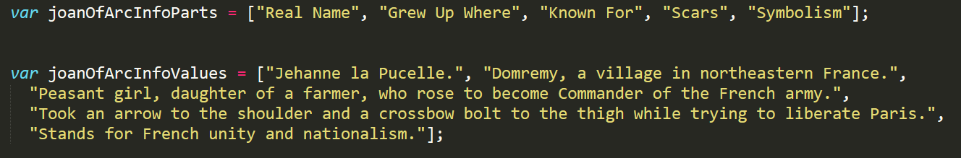
Associated Data ==/== Arrays
Relating two separate arrays is not fun.

Slide 22
Code That Proves It
var stuffThatsMoreFunThanProgrammaticallyAssociatingArrays = [];
stuffThatsMoreFunThanProgrammaticallyAssociatingArrays.push(“Root Canal”);
stuffThatsMoreFunThanProgrammaticallyAssociatingArrays.push(“Paying Taxes”);
stuffThatsMoreFunThanProgrammaticallyAssociatingArrays.push(“Working with CSS”);
stuffThatsMoreFunThanProgrammaticallyAssociatingArrays.push(“Hawaiian Pizza”);
stuffThatsMoreFunThanProgrammaticallyAssociatingArrays.push(“Watching C-SPAN”);
stuffThatsMoreFunThanProgrammaticallyAssociatingArrays.push(“Cleaning the bathrooms at GCS with a toothbrush”);
console.log(stuffThatsMoreFunThanProgramaticallyAssociatingArrays);

Slide 23
Demo Time
Instructor: Demo
(gandalf-the-grey-objects.html | 30-GandalfTheGreyObjects)

Slide 24
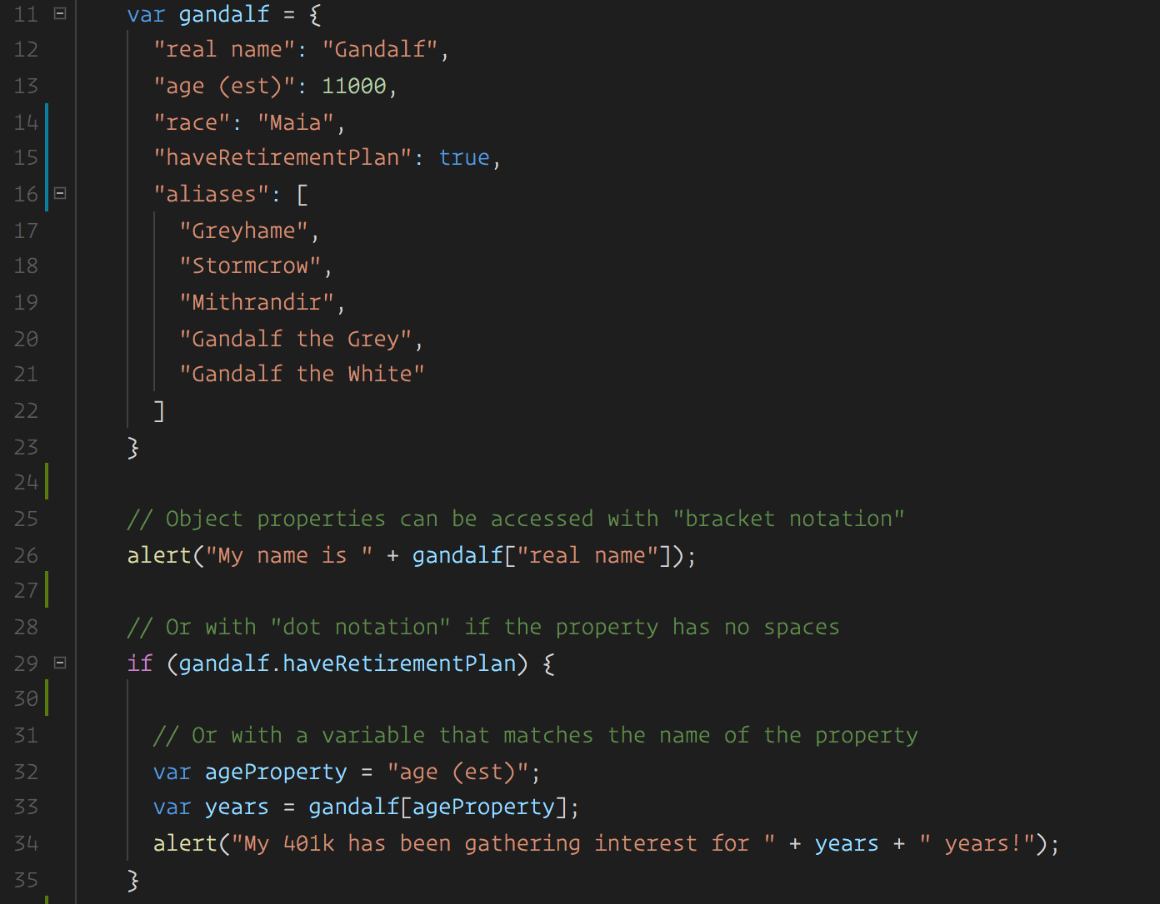
Gandalf – The Object
Gandalf’s “properties” and “values” are associated in object form, making it easy to recall specific data.

Slide 25
Objects Visualized
var gandalf
=
{
“real name”
:
“Gandalf”
,
“age (est)”
:
11000
,
“race”
:
“Maia”
}
This is Gandalf. According to code… Gandalf is an Object.

Slide 26
Objects Visualized
var gandalf
=
{
“real name”
:
“Gandalf”
,
“age (est)”
:
11000
,
“race”
:
“Maia”
}
These are Gandalf’s properties (like descriptors).

Slide 27
Objects Visualized
var gandalf
=
{
“real name”
:
“Gandalf”
,
“age (est)”
:
11000
,
“race”
:
“Maia”
}
These are the “values” of Gandalf’s properties.

Slide 28
Objects Visualized
var gandalf
=
{
“real name”
:
“Gandalf”
,
“age (est)”
:
11000
,
“race”
:
“Maia”
}
Thus: gandalf[“race”] = “Maia

Slide 29
Pr0grammer W0rds
Objects in JavaScript can also be called:
Dictionaries: note how it looks like a dictionary entry with a term on one side and a definition on the other
Associative Arrays: An array value is associated with a property name
Key-Value-Pairs (KVP’s): This is an EXTREMELY COMMON pattern in software development. The key is the property name, the value is the value.

Slide 30
Pr0grammer W0rds
Dot Notation Syntax
You can dereference the values using their keys using array notation:
console.log(Gandalf[“race”]);
Or you can use dot notation:
console.log(Gandalf.race);
Now that you know that, what do you make of this?
console.log(Gandalf.race.length);
console.log(Gandolf.name.charAt(3));
MANY languages use Dot Notation:
var languagesWithDots = [‘javascript’, ‘C#’, ‘Java’, ‘Python’, ‘Swift’, ‘Go’]; //and many more

Slide 31
Mind Blowing Revelation
Objects are not limited to simple key value pairs:
var Gandalf = {
name: ‘Gandalf’,
age: 11000,
race: ‘Maia’,
carriesAStick: true
}

Slide 32
Mind Blowing Revelation
Objects are not limited to simple key value pairs:
var Gandalf = {
name: ‘Gandalf’,
age: 11000,
race: ‘Maia’,
carriesAStick: true ,
favoriteFoods: [‘cookies’, ‘cakes’, ‘life-savers’],
favoriteWeapon: {
name: “staff”,
length: 7,
material: “oak” },
printToJumboTron: function(){
… make some html and put it in the jumbo tron…
}
}
You can use arrays for values!
You can use OBJECTS for values!
You can even use FUNCTIONS for values!

Slide 33
Demo Time
Instructor: Repeat Demo
(gandalf-the-grey-objects.html | 30-GandalfTheGreyObjects)

Slide 34
> YOUR TURN!!
Activity: 31-MyFirstObject | Suggested Time: 15 min
Code Dissection / Creation: Basic Objects
With a partner, spend the next few moments studying the code just slacked to you.
Then, write code below each comment to log the relevant information about the provided car object.
Bonus: If you finish early, create a brand new object of your own. Slack out a snippet of the code to the class when you are done. Be Creative!

Slide 35
Demo Time
Instructor: Demo in Browser
(carGame_Solved.html | 32-CarGame)

Slide 36
> YOUR TURN!!
Activity: 32-CarGame | Suggested Time: 20-30 min
Code Creation: Run that Car!
Using the code from the previous activity as a starting point, create a complete application such that:
Users can enter keyboard input (letters).
Each of the car's methods are assigned to a key.
When the user presses a key it calls the appropriate function.
These letters also trigger a global function called reWriteStats() that logs the car’s make, model, color, mileage, and isWorking status to the console.
HINT: You will need to use the document.onkeyup() function to collect input from the user's keyboard.

Slide 37
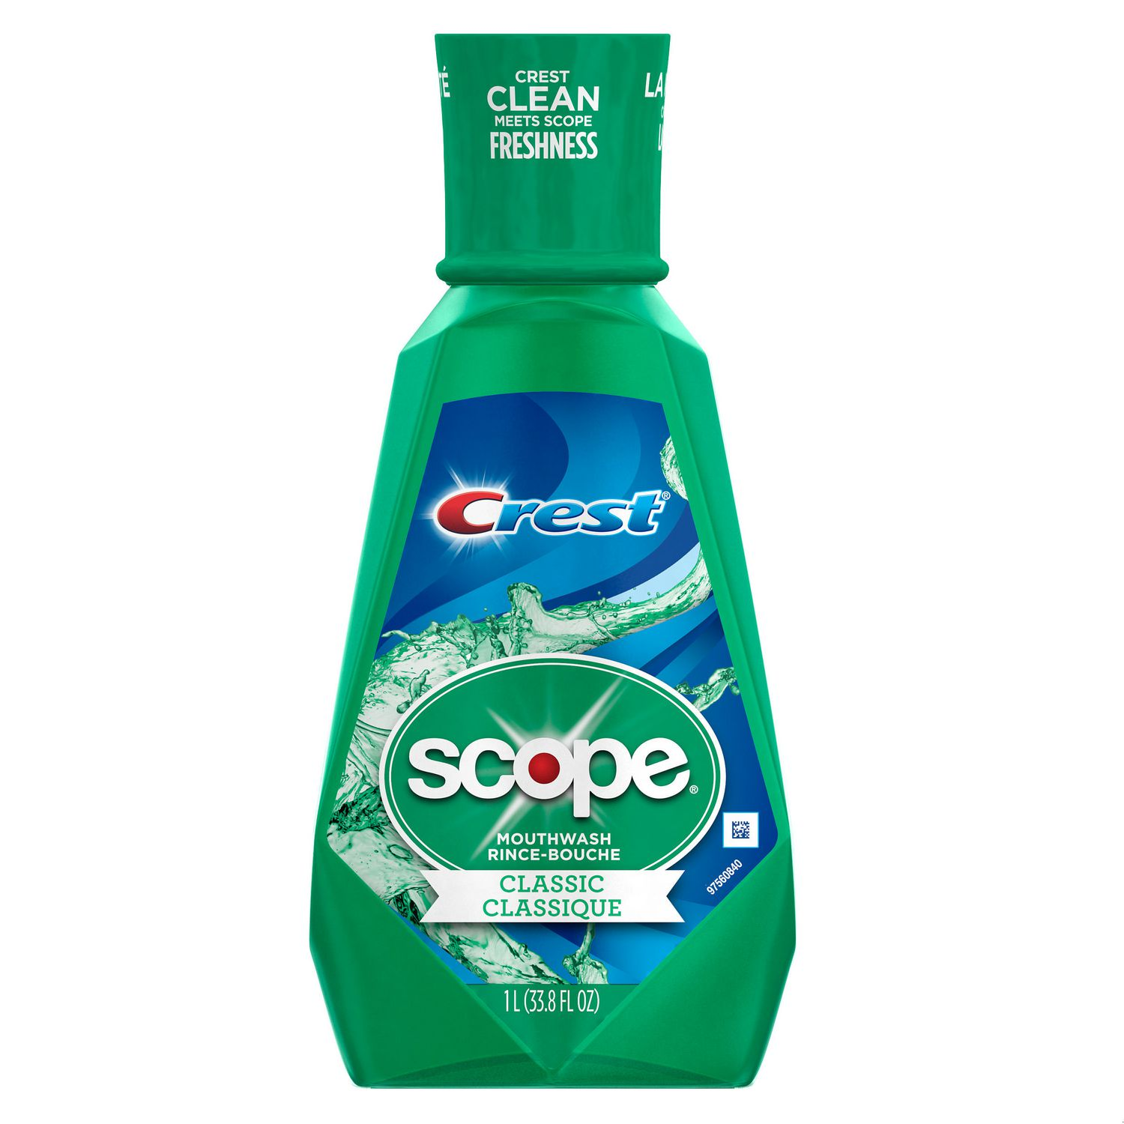

Scope & Stuff
Everyone Do: Scope & Callbacks

Slide 38
> YOUR TURN!!
Activity: 33-Scope | Suggested Time: 5 min
Code Dissection: Scopes Trial (sans monkeys)
Run the program sent to you via slack. 33-Scope/scope-examples.html
Then, with a partner, figure out just what the Hector Heathcotes is going on in this code.
See if you can fully why each function call behaves as it does. Pay very close attention to WHERE variables are declared and set.
Be prepared to share with the class.

Slide 39
Scope is all about Lifecycle
Variables created outside of a function or outside the context of an object are global. They are created (and are then “in scope”) when the page loads. Global variables are destroyed (they go “out of scope”) when the browser window closes.
<script>
var name = "Peleke";
var age = 92;
var languages = ["English", "Norwegian", "Spanish"];
var firstFunction = function(message) {
var output = message + name + " is " + age + ".";
console.log(output);
};
// "Oh, my! Peleke is 92."
firstFunction("Oh my! ");
…

Slide 40
Scope is all about Lifecycle
Variables created inside a function only exist within the confines of that function which is demarcated by the curly braces. It goes out of scope when the function exits.
<script>
var name = "Peleke";
var age = 92;
var languages = ["English", "Norwegian", "Spanish"];
var firstFunction = function(message) {
var output = message + name + " is " + age + ".";
console.log(output); //after this statement output is no longer in scope
};
//so this won’t work – output is undefined b/c it went out of scope!!!
console.log(output);
// "Oh, my! Peleke is 92.“
firstFunction("Oh my! ");

Slide 41
Scope is all about Lifecycle
If you code in other languages – this is an oddity in JavaScript:
What you expect:
Variables created inside any curly brace construct (if statement blocks, loop blocks, etc.) are in scope within those braces.
What really is:
They are still in scope!!!!

Slide 42
Scope is all about Lifecycle
// Looping through our myFarm array.
var myFarm = ["chickens", "pigs", "cows", "horses", "ostriches"];
for (var j = 0; j < arrayLength; j++) {
var testAnimal = myFarm[j];
console.log(testAnimal);
}
alert("this should not work: " + testAnimal); //ostriches

Slide 43
Demo Time
TA: Demo
(Homework Videos!)

Slide 44
> YOUR TURN!!
Activity: 9-TriviaGame | Suggested Time: 45 min
Extra Activity: Trivia Game
With whatever class time remains, complete the following activity in pairs.
Starting from a blank HTML file:
Create an object with 10 questions. The object should be structured like this: q1: [“QUESTION”, “ANSWER”] q2: [“QUESTION”, “ANSWER”]
Then create code that will ask the user questions, one by one. The user must answer by hitting t (for true) or f (for false).
Check the user’s answer against the correct answer, and provide them with an alert telling them if they are right or wrong.
Bonus: Keep track of the user’s score.
Hint: Don’t worry about having DRY code to start with. Just focus on getting working code first.

Slide 45
Questions

